Slide 1
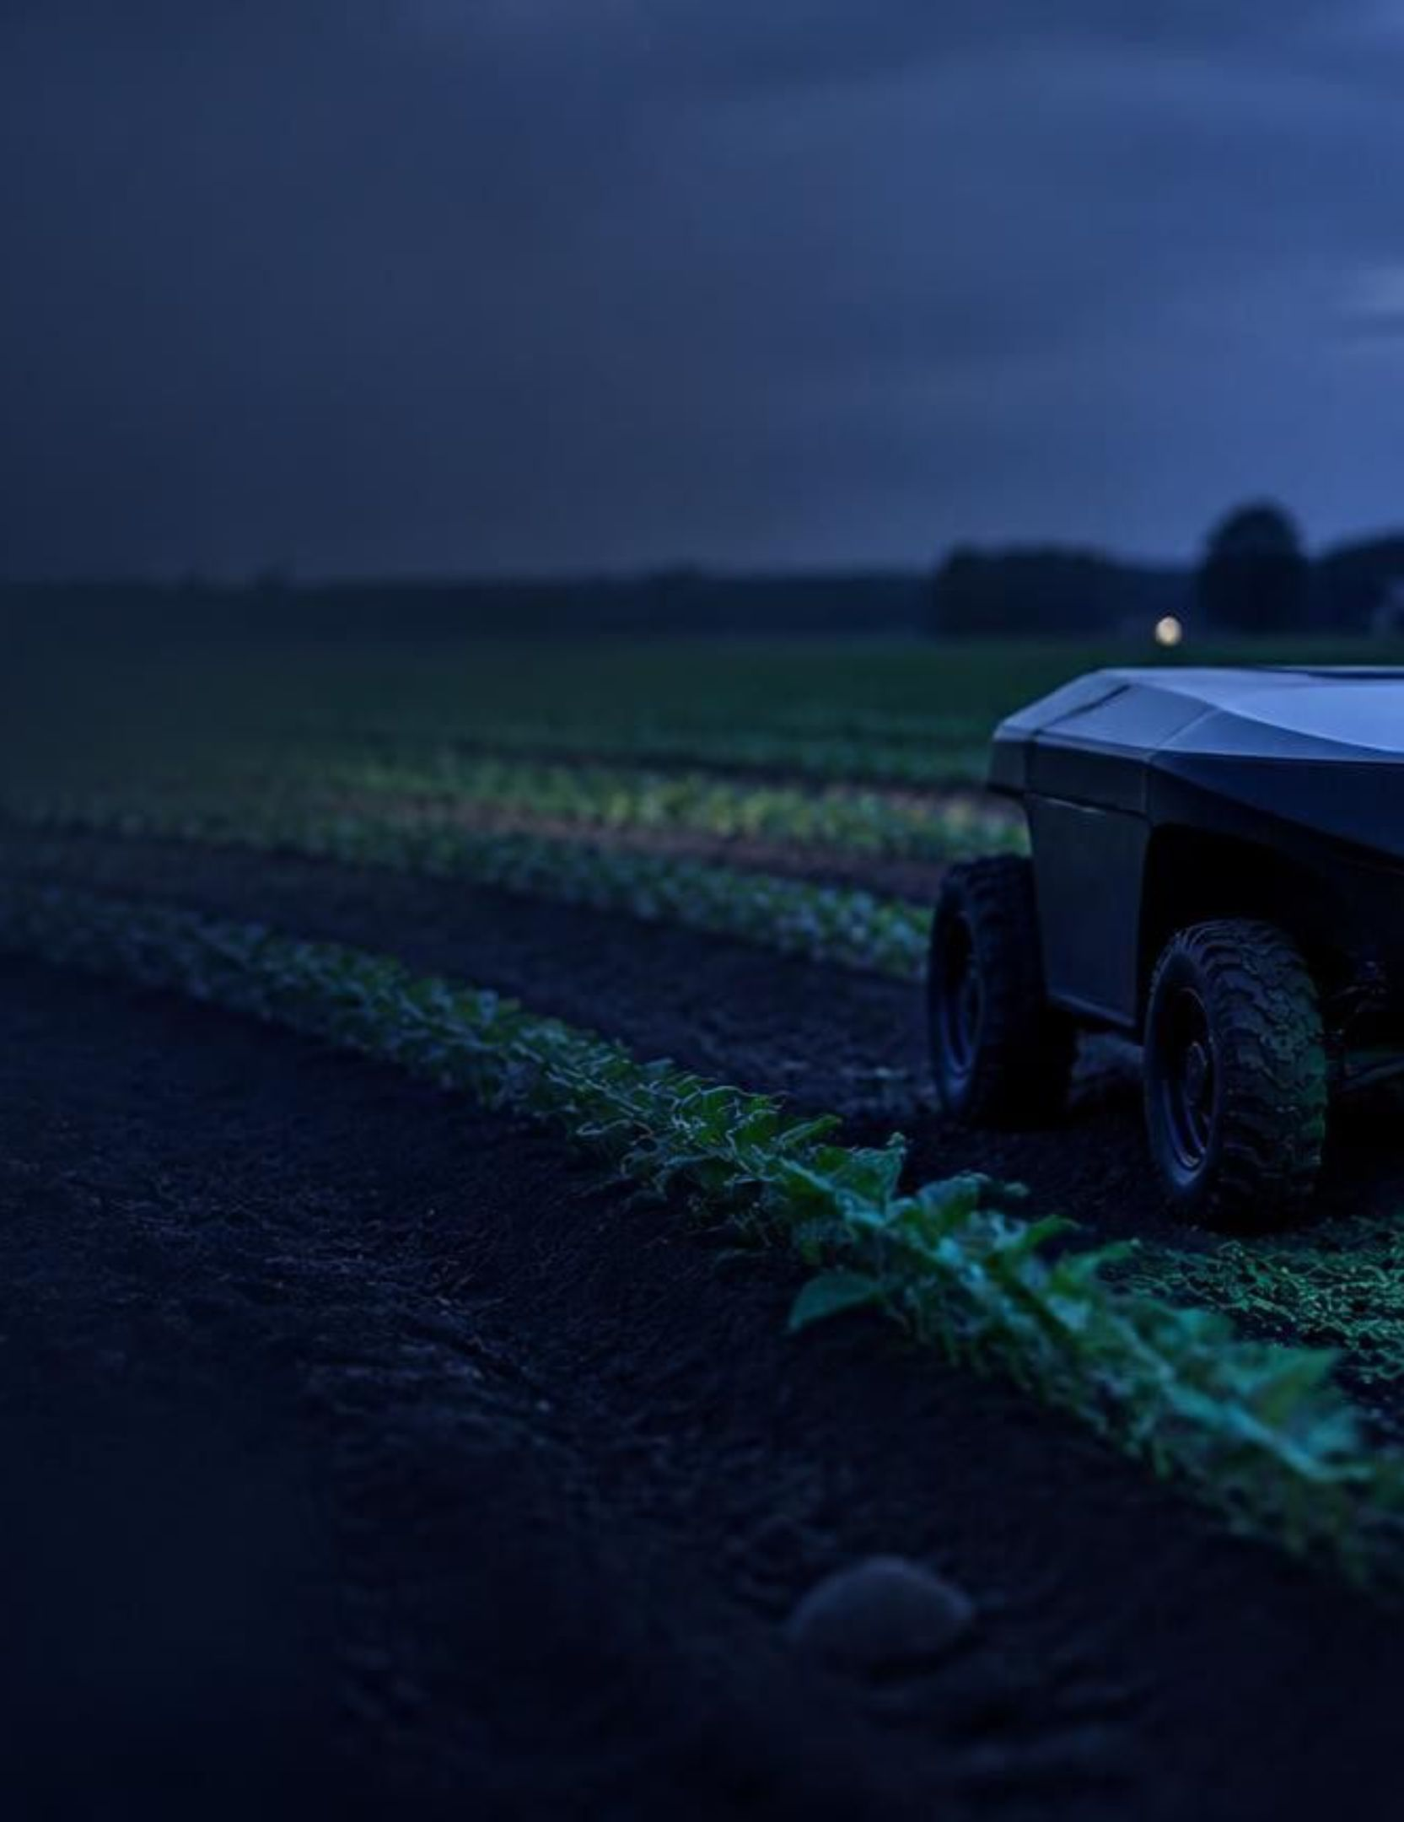
AI AGRICULTURE · FIELD SYSTEMS
Next-Gen AI
Agricultural Rover
Autonomous edge vision, soil sensing, and smart irrigation for more precise small-scale farming.

Slide 2
01 · THE PROBLEM
Small farms lose time, water, and yield before they can react
Resource waste
Over-irrigation and improper fertilizer application degrade soil and waste water.
Late disease detection
Manual inspection delays diagnosis and increases crop-loss risk.
Labor intensity
Repeated soil monitoring across field areas is slow and inefficient.

Slide 3
02 · THE SYSTEM
One mobile platform turns field signals into action
A closed loop: sense the field, interpret it locally, then respond where the crop needs it.
Monitor
See
Act
A multi-sensor rover collects live soil and crop telemetry.
Edge computer vision assesses crop health and identifies disease on-device.
Targeted irrigation triggers when real-time soil moisture crosses a threshold.

Slide 4
03 · THE STACK
A modular stack keeps the rover affordable and adaptable
Component | Part Selected | Functional Role
Vision + AI | XIAO ESP32S3 Sense | Vision and AI processing
Drive + control | ESP8266 plus servos and relay | Motor drive, camera gimbal, and pump control
Soil telemetry | Capacitive soil moisture sensor | Analog soil moisture telemetry
Safety monitoring | Gas/flame and motion sensors | Safety monitoring
Status display | SSD1306 OLED | Status and telemetry
Power | 2S 18650 pack plus BMS and buck converter | Regulated 5V high-current dual-rail supply

Slide 5
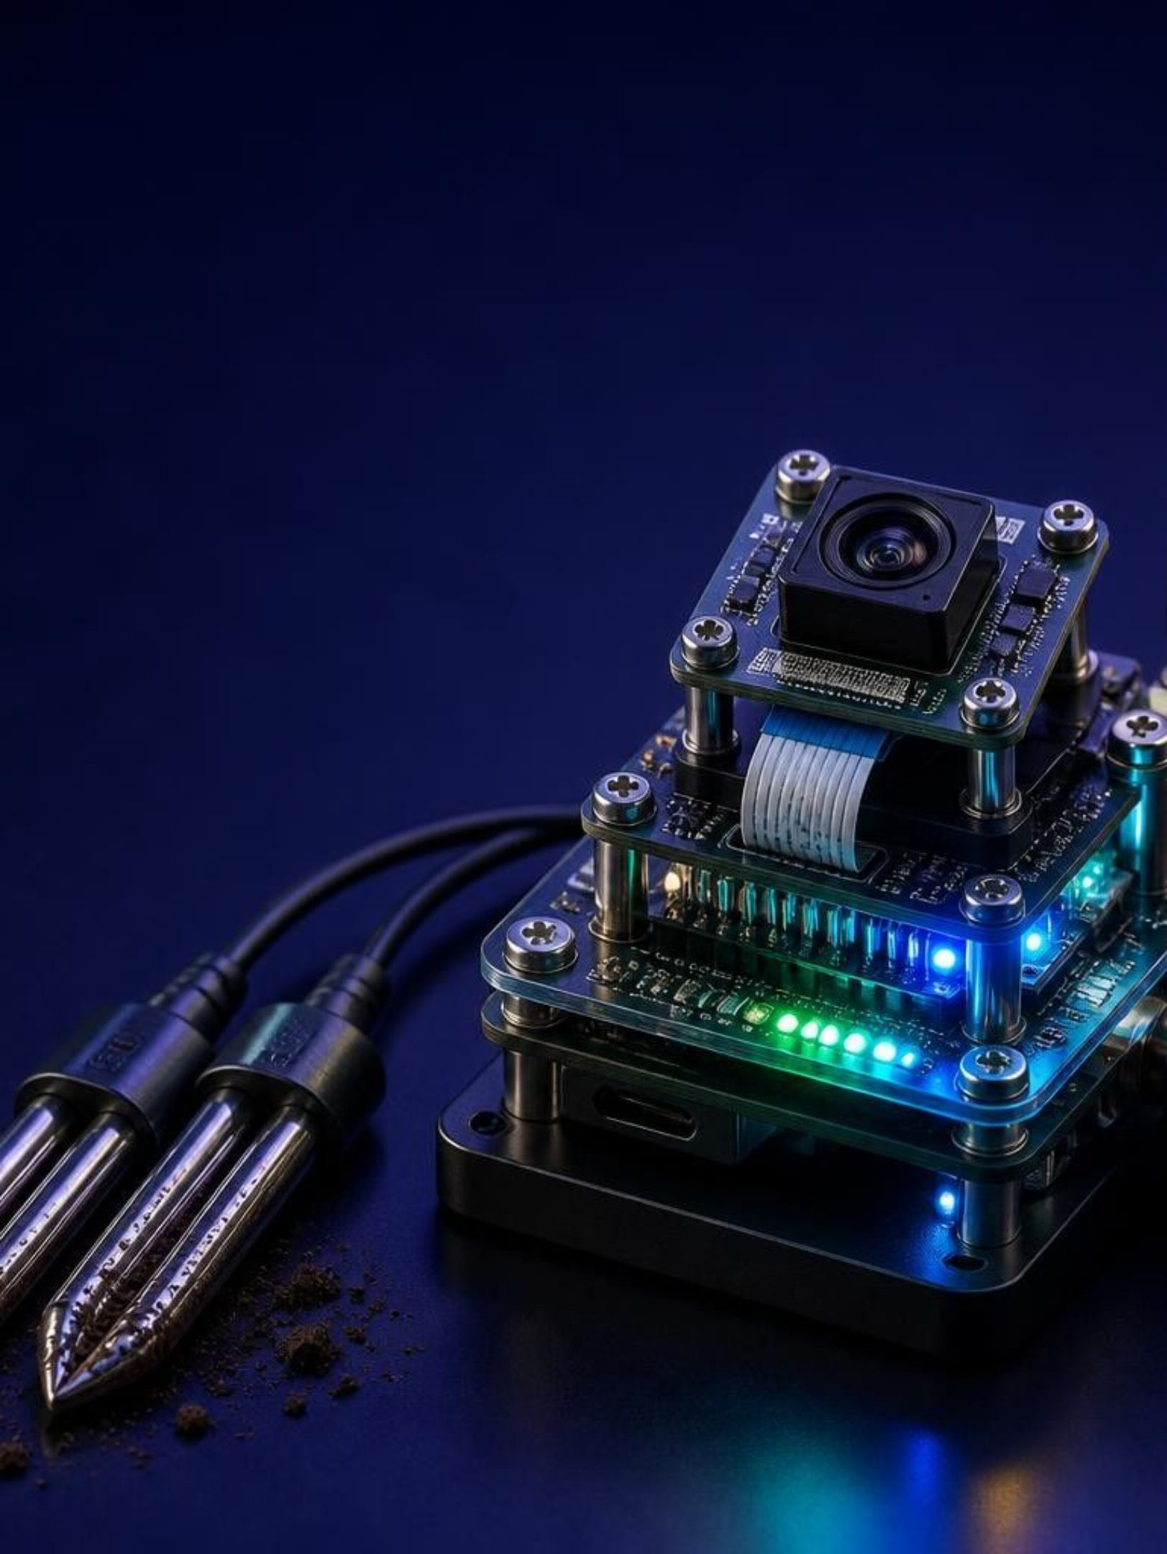

04 · EDGE INTELLIGENCE
Edge intelligence makes every decision local
On-device inferencing: vision models run directly on the XIAO ESP32S3 Sense without active internet.
Low power and cost: high-performance vision in a compact, lower-cost architecture.
Low latency: immediate decisions support spot spraying and crop targeting.

Slide 6
05 · VALIDATION
The prototype already connects sensing, power, and vision
Hardware integration
Safe power
Complete hardware integration built and field-tested.
Safe 2S Li-ion integration with BMS and buck converter for servo stability.
Live telemetry
Local vision
Multi-sensor telemetry streaming to display and control outputs.
Active image capture and local inferencing through the ESP32S3 Sense camera.

Slide 7
06 · THE OPPORTUNITY
A low-cost rover can serve the next wave of growers
Target users
Value proposition
Sustainability impact
Smallholder farmers, urban hydroponic setups, educational institutions, and automated greenhouses.
An accessible entry point versus heavy industrial ag-tech equipment.
Target-driven irrigation is designed to reduce water use by up to 30% and minimize chemical fertilizer runoff.

Slide 8
07 · THE ROAD AHEAD
From functional prototype to cooperative farm pilots
A staged path from validated hardware to autonomous field operation and commercial pilot testing.
Phase 1 — Current
Phase 3
Functional prototype built, edge AI vision trained, and localized irrigation verified.
Commercial pilot testing with local greenhouses and farm cooperative networks.
1
2
3
Phase 2
Autonomous pathfinding, GPS waypoint navigation, and long-range LoRa telemetry.

